Slide 1
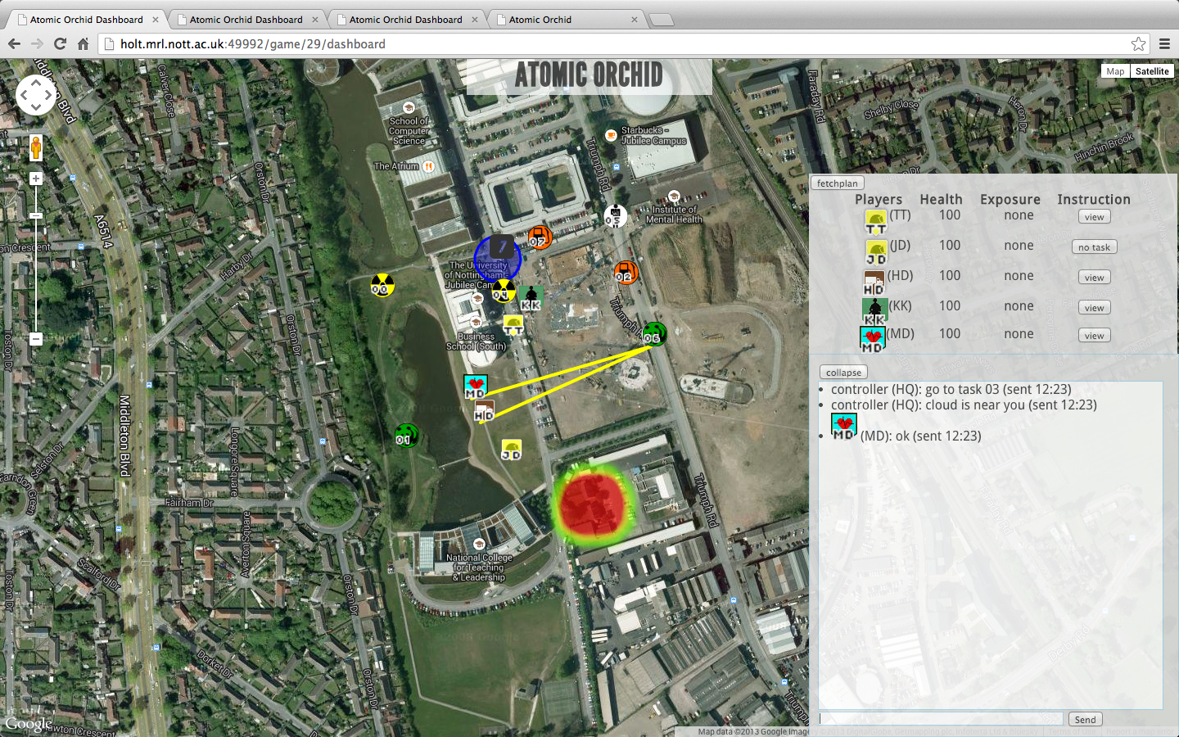
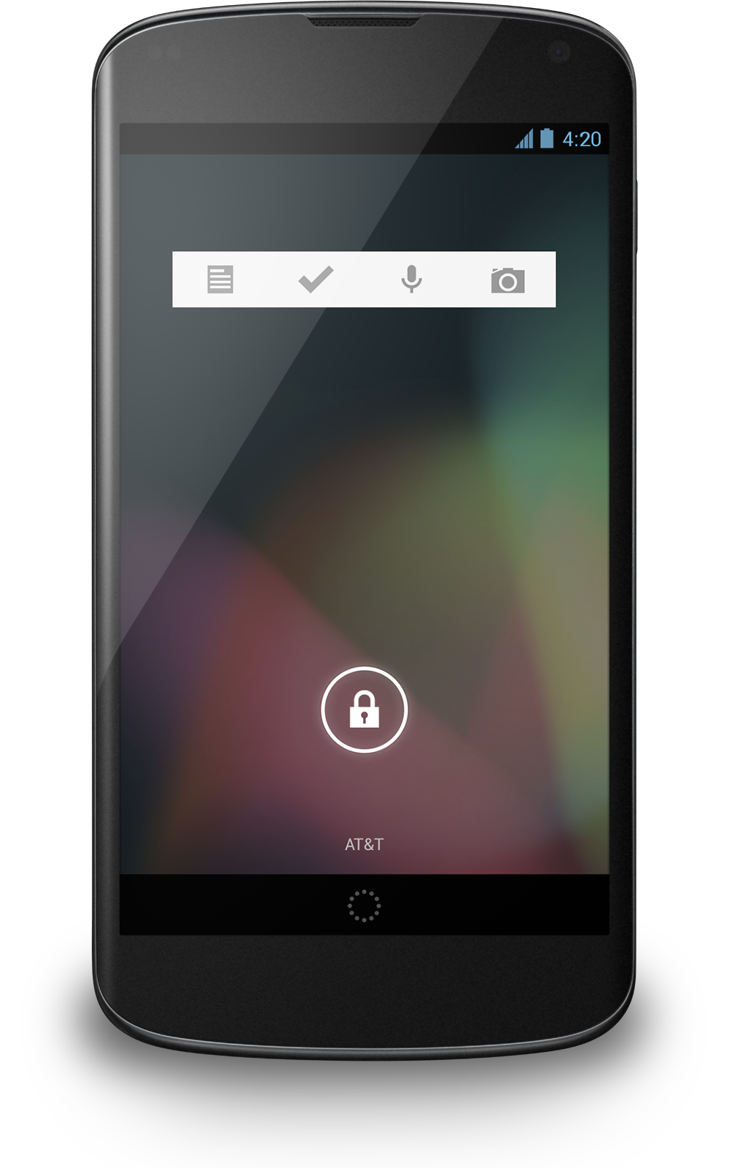
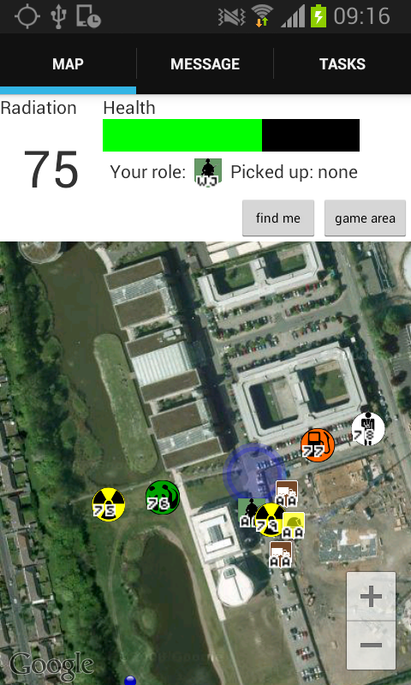
HQ Dashboard
Mobile Responder App
Drop off zone
Task allocation
Player status widget
Player and target icons
Radioactive cloud
Messaging widget

Slide 2
HQ Dashboard
Drop off zone
Task allocation
Player status widget
Player and target icons
Radioactive cloud
Messaging widget

Slide 3
Tab for messages from HQ
Tab for
Instructions from agent
Health status
Local radiation
level
Map of all targets,
Drop-off zones, and other players
Mobile Responder Tool

